Slide 1
Social Media
Analysis
Prajyot .P. Naik

Slide 2
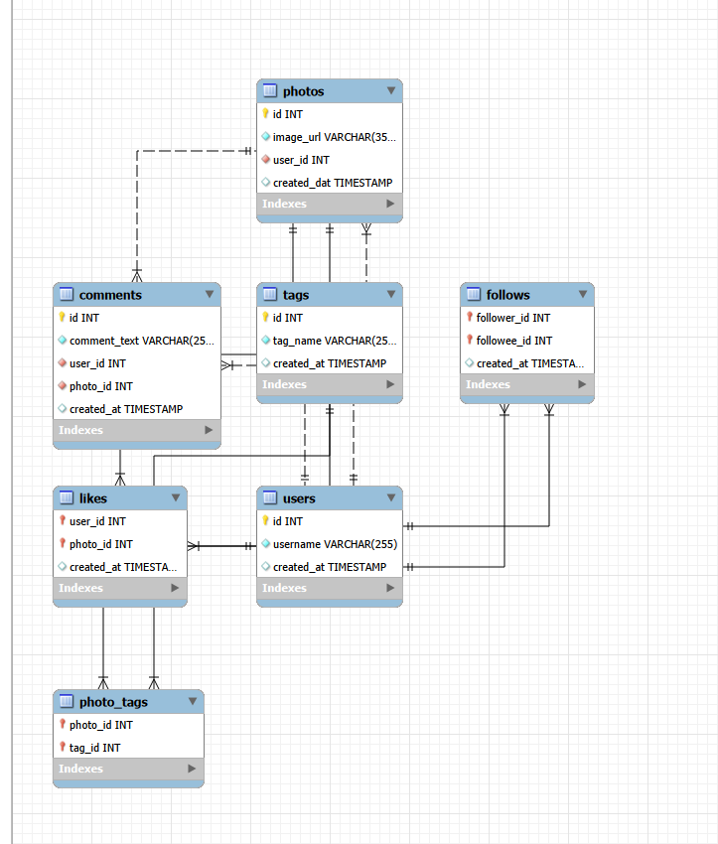
Problem Statement
Analyze Instagram user activity and engagement data to generate insights that help marketing teams design targeted campaigns to increase user engagement, retention, and platform growth.
Database Schema

Slide 3
Objectives of the analysis
01
Primary Objectives
Analyze user engagement patterns (likes, comments, activity)
Identify highly active and valuable users
Discover popular content types and hashtags
Understand posting behavior and activity levels
Detect inactive users and opportunities for re-engagement

Slide 4
Objectives of the analysis
02
Business Goals
Improve user retention on the platform
Increase overall engagement rates
Support targeted marketing campaigns
Identify potential influencers and brand advocates
Drive user acquisition through data-driven insights

Slide 5
Data Overview
Users: Contains account details of all platform users, including unique ID, username, and account creation timestamp.
Photos (Posts): Represents content shared by users. Each record corresponds to a photo posted by a specific user along with its upload time.
Likes: Captures user engagement by recording which user liked which photo, indicating content popularity.
Comments: Stores textual feedback on photos. Each comment is linked to both the commenting user and the associated photo.
Follows: Represents social relationships between users by tracking follower–followee connections within the platform.
Tags (Hashtags): Contains hashtag information used to categorize content and identify topics or themes.
Photo_Tags: Acts as a bridge table connecting photos and hashtags, enabling multiple tags per photo and supporting topic-based analysis.

Slide 6
Methodology / Analysis Approach
Data Understanding
Data Cleaning
& Validation
SQL
Analysis
User Segmentation
Trend Identification
Insight Generation

Slide 7
Data Quality Assessment
(Duplicates & NULL Values)
Duplicate Values Check
Verified uniqueness of usernames and tag names
Ensured no duplicate likes or follow relationships
Confirmed unique photo–tag mappings

Slide 8
Data Quality Assessment
(Duplicates & NULL Values)
Missing Values Check
Examined key fields across all tables
No significant NULL values found in critical columns

Slide 9
Data Quality Assessment
(Duplicates & NULL Values)
Conclusion
Dataset is clean and reliable for analysis
No major data quality issues detected

Slide 10
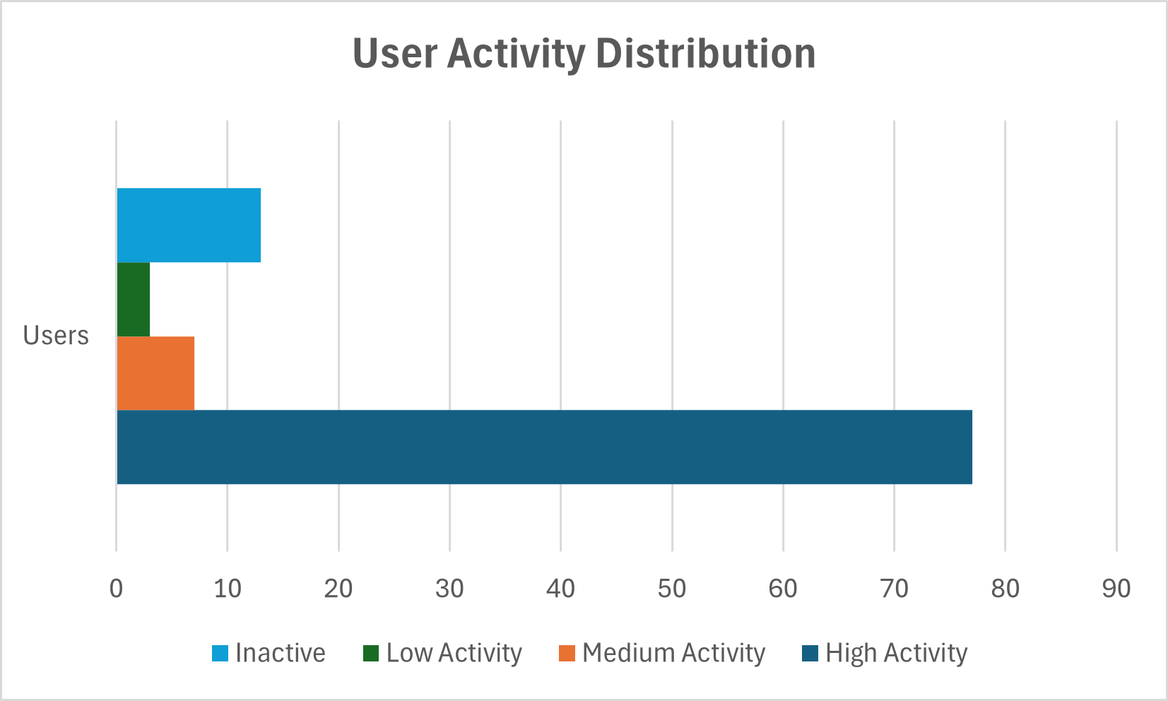
User Activity Distribution
Insight
The majority of users fall into the High Activity category
Only a small portion of users are inactive or low activity
This indicates strong engagement on the platform but highlights opportunities to re-engage inactive users

Slide 11
Influencers & High-Engagement Users
Key Findings
Interpretation
A small group of users has both high follower counts and strong engagement per post
These users generate significantly more interaction than others
High engagement indicates an active and loyal audience
These users act as key content drivers on the platform
Their posts reach large audiences and spark conversations
They have strong influence over community behavior
Business Insight
Ideal candidates for influencer marketing campaigns
Can amplify brand visibility and campaign reach
Valuable for partnerships, promotions, and platform initiatives

Slide 12
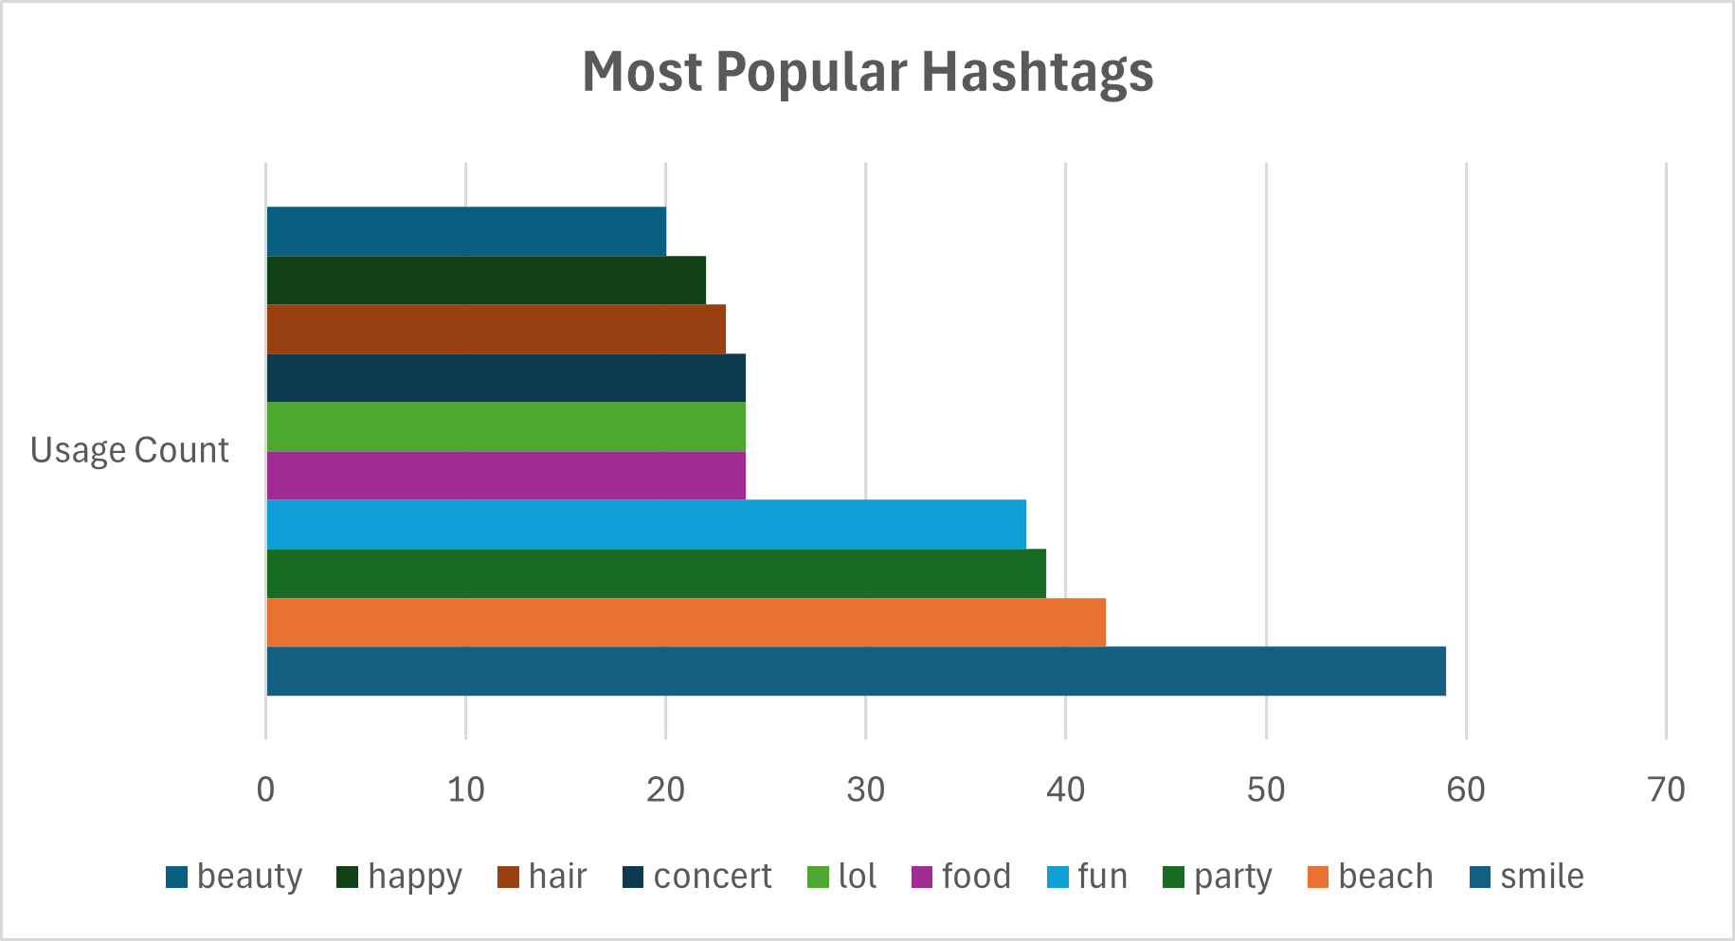
Content & Hashtag Trends
Insights
Lifestyle and leisure tags such as smile, beach, party, and fun dominate user content.
Positive and social experiences appear to drive the majority of posts.
Brands can leverage these themes to design more relatable and engaging campaigns.

Slide 13
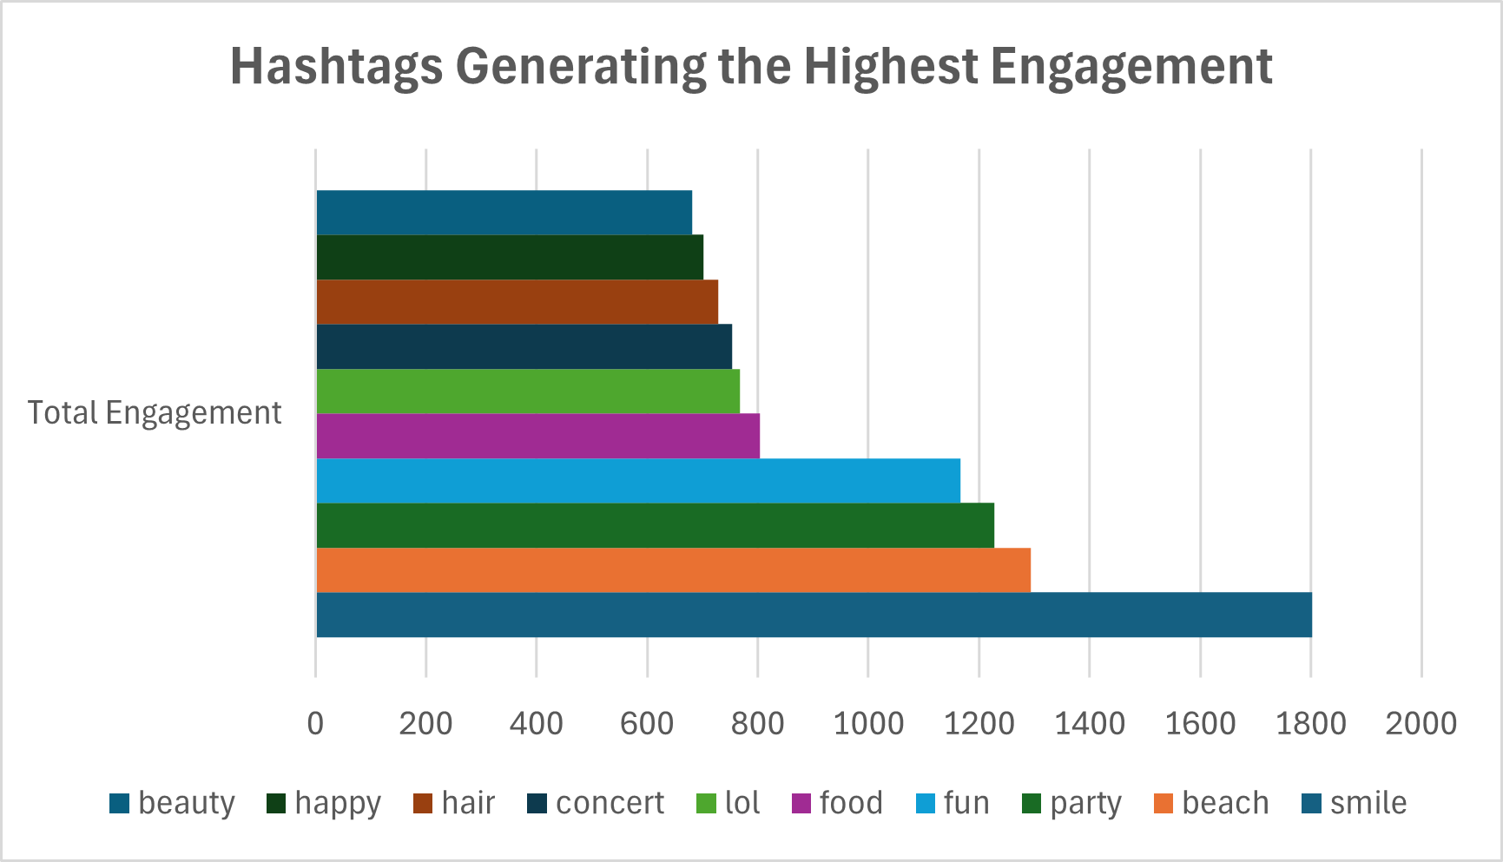
High Engagement Content Topics
Insights
Hashtags like smile, beach, party, and fun generate the highest engagement across the platform.
Content associated with positive emotions and lifestyle activities tends to perform better.
Marketers can prioritize these themes when designing campaigns to maximize reach and interaction.

Slide 14
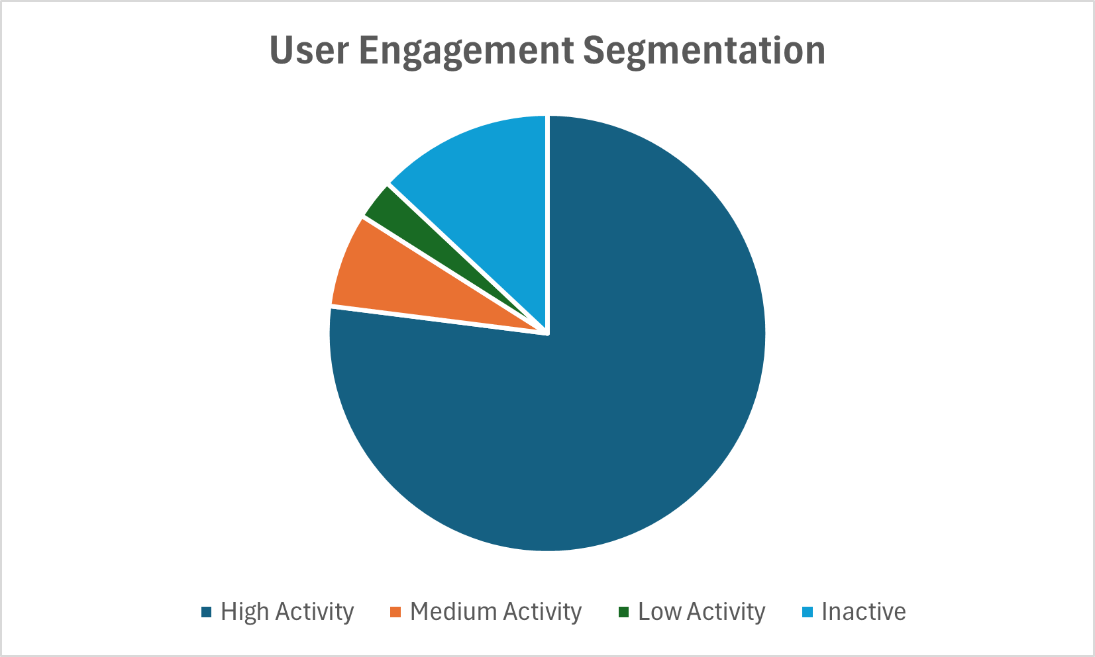
User Segmentation & Behaviour
Insight
Most users are highly active, indicating strong engagement on the platform.
However, a small segment of inactive users represents an opportunity for re-engagement campaigns.
Targeted strategies such as notifications, content recommendations, and reward systems can help reactivate these users.

Slide 15
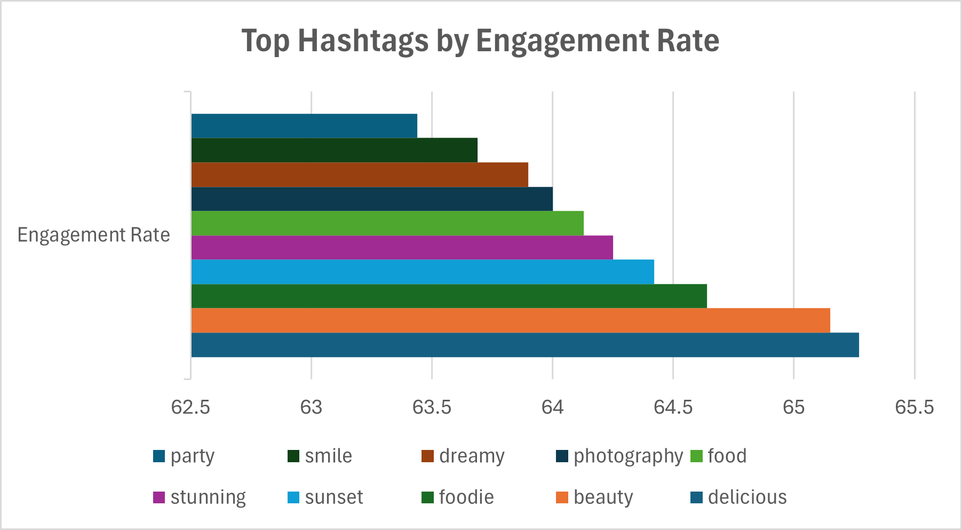
High Engagement Hashtags
Insight
Food and lifestyle-related hashtags such as delicious, foodie, and beauty show the highest engagement.
Visual-centric themes like sunset and photography also perform well.
Brands can use these high-engagement topics to design targeted campaigns and influencer collaborations.

Slide 16
Marketing Insights & Recommendations
Key Findings
Engagement is driven by a core group of highly active users
Influencers play a major role in content visibility
Trending topics significantly impact interaction rates
Inactive users represent untapped growth potential

Slide 17
Marketing Insights & Recommendations
Recommended Strategies
Collaborate with high-engagement users for campaigns
Promote content using trending hashtags and themes
Provide incentives to retain highly active users
Launch re-engagement initiatives for inactive users

Slide 18
Marketing Insights & Recommendations
Expected Impact
Increased user engagement and retention
Improved effectiveness of marketing campaigns
Stronger community growth and platform activity

Slide 19
User Segmentation & Behaviour
Key Findings
Interpretation
Users can be grouped into distinct behavioral segments:
Highly Engaged Users
Content Creators
Passive Consumers
Inactive Users
Highly engaged users actively like and comment on content
Content creators drive the supply of posts
Passive users consume content with minimal interaction
Inactive users represent potential churn risk
Business Insight
Different segments require different engagement strategies
Personalized recommendations can improve user experience
Targeted campaigns can increase retention and activity

Slide 20
Conclusion
This analysis of the Instagram-like dataset reveals that platform engagement is largely driven by a core group of highly active users, influential content creators, and popular content themes. Users demonstrate diverse behavioral patterns, ranging from highly engaged participants who frequently interact with content to passive consumers and inactive accounts that represent potential growth opportunities.
High-engagement users and influencers play a crucial role in amplifying content reach and sustaining community activity, while trending hashtags and relatable topics significantly enhance visibility and interaction rates.
By segmenting users based on their activity and engagement levels, targeted marketing strategies can be developed to retain valuable users, re-engage dormant ones, and optimize content delivery. Overall, leveraging these data-driven insights enables more effective decision-making, improved user experience, stronger retention, and sustainable platform growth through focused campaigns and strategic collaborations.

